Slide 1
Chapter 7: ENERGY

Slide 2
This lecture will help you understand:
Energy
Work
Power
Mechanical Energy : Potential and Kinetic
Work-Energy Theorem
Conservation of Energy
Machines
Efficiency
Recycled Energy
Energy for Life
Sources of Energy

Slide 3
Energy
A combination of energy and matter make up the universe.
Energy
  Mover of substances
  Both a thing and a process
  Observed when it is being transferred or being transformed
  A conserved quantity

Slide 4
Energy
Property of a system that enables it to do work
Anything that can be turned into heat
Example: Electromagnetic waves from the Sun
Matter
Substance we can see, smell, and feel
Occupies space

Slide 5
Work
Work
involves force and distance.
is force × distance.
in equation form: W = Fd.
Two things occur whenever work is done:
application of force
movement of something by that force

Slide 6
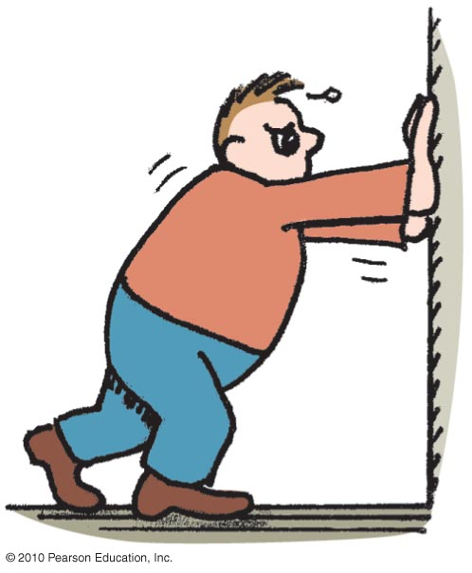
If you push against a stationary brick wall for several minutes, you do no work
Work
CHECK YOUR NEIGHBOR
A. on the wall.
at all.
Both of the above.
None of the above.
Notes:
A. on the wall.

Slide 7
If you push against a stationary brick wall for several minutes, you do no work
Work
CHECK YOUR ANSWER
A. on the wall.
at all.
Both of the above.
None of the above.
Explanation:
You may do work on your muscles, but not on the wall.
Notes:
A. on the wall.

Slide 8
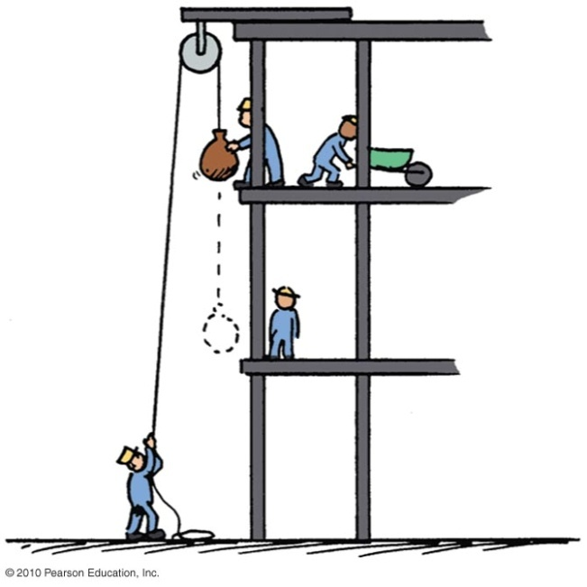
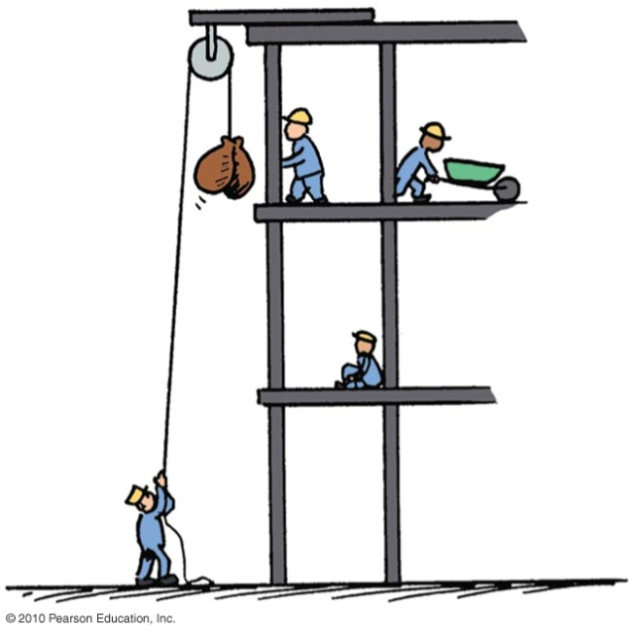
Work
Examples:
Twice as much work is done in lifting 2 loads 1 story high versus lifting 1 load the same vertical distance.
  Reason: force needed to lift twice the load is twice as much.
Twice as much work is done in lifting a load 2 stories instead of 1 story.
  Reason: distance is twice as great.

Slide 9
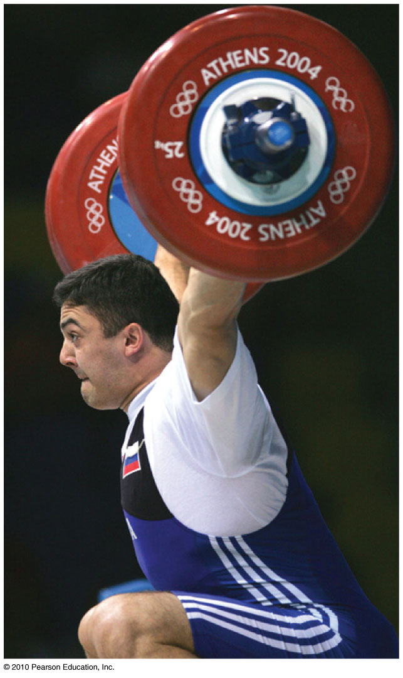
Work
Example:
  a weightlifter raising a barbell from the floor does work on the barbell.
Unit of work:
newton-meter (Nm)
or joule (J)
Concept check: The weightlifter does work in raising the barbell, what about holding it over his head?
No- while he may struggle to hold it over his head, there is no distance traveled, and hence no work done.

Slide 10
Work is done in lifting a barbell. How much work is done in lifting a barbell that is twice as heavy the same distance?
Work
CHECK YOUR NEIGHBOR
A. Twice as much
Half as much
The same
Depends on the speed of the lift
Notes:
A. Twice as much.

Slide 11
Work is done in lifting a barbell. How much work is done in lifting a barbell that is twice as heavy the same distance?
Work
CHECK YOUR ANSWER
A. Twice as much
Half as much
The same
Depends on the speed of the lift
Explanation:
This is in accord with work = force × distance. Twice the force for the same distance means twice the work done on the barbell.
Notes:
A. Twice as much.

Slide 12
You do work when pushing a cart with a constant force. If you push the cart twice as far, then the work you do is
Work
CHECK YOUR NEIGHBOR
A. less than twice as much.
twice as much.
more than twice as much.
zero.
Notes:
B. twice as much.

Slide 13
You do work when pushing a cart with a constant force. If you push the cart twice as far, then the work you do is
Work
CHECK YOUR ANSWER
A. less than twice as much.
twice as much.
more than twice as much.
zero.
Notes:
B. twice as much.

Slide 14
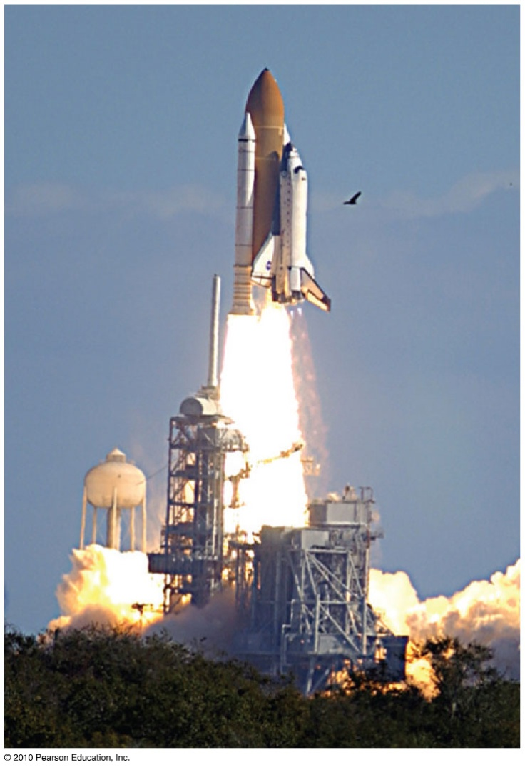
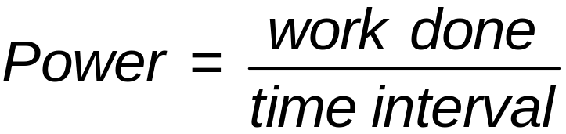
Power
Power:
Measure of how fast work is done
In equation form:

Slide 15
Power
Example:
  A worker uses more power running up the stairs than climbing the same stairs slowly.
  Twice the power of an engine can do twice the work of one engine in the same amount of time, or twice the work of one engine in half the time or at a rate at which energy is changed from one form to another.

Slide 16
Power
Unit of power
joule per second, called the watt after James Watt, developer of the steam engine
  1 joule/second = 1 watt
  1 kilowatt = 1000 watts

Slide 17
A job can be done slowly or quickly. Both may require the same amount of work, but different amounts of
Power
CHECK YOUR NEIGHBOR
A. energy.
momentum.
power.
impulse.
Notes:
C. power.

Slide 18
A job can be done slowly or quickly. Both may require the same amount of work, but different amounts of
Power
CHECK YOUR ANSWER
A. energy.
momentum.
power.
impulse.
Comment:
Power is the rate at which work is done.
Notes:
C. power.

Slide 19
Mechanical Energy
Mechanical energy is due to position or to motion, or both.
There are two forms of mechanical energy:
Potential energy
Kinetic energy

Slide 20
Potential Energy
Stored energy held in readiness with a potential for doing work
Example:
  A stretched bow has stored energy that can do work on an arrow.
  A stretched rubber band of a slingshot has stored energy and is capable of doing work.

Slide 21
Potential Energy—Gravitational
Potential energy due to elevated position
Example:
  water in an elevated reservoir
  raised ram of a pile driver

Slide 22
Potential Energy—Gravitational
Equal to the work done (force required to move it upward × the vertical distance moved against gravity) in lifting it
In equation form:
  Potential energy
  = mass × acceleration due to gravity × height
  = mgh

Slide 23
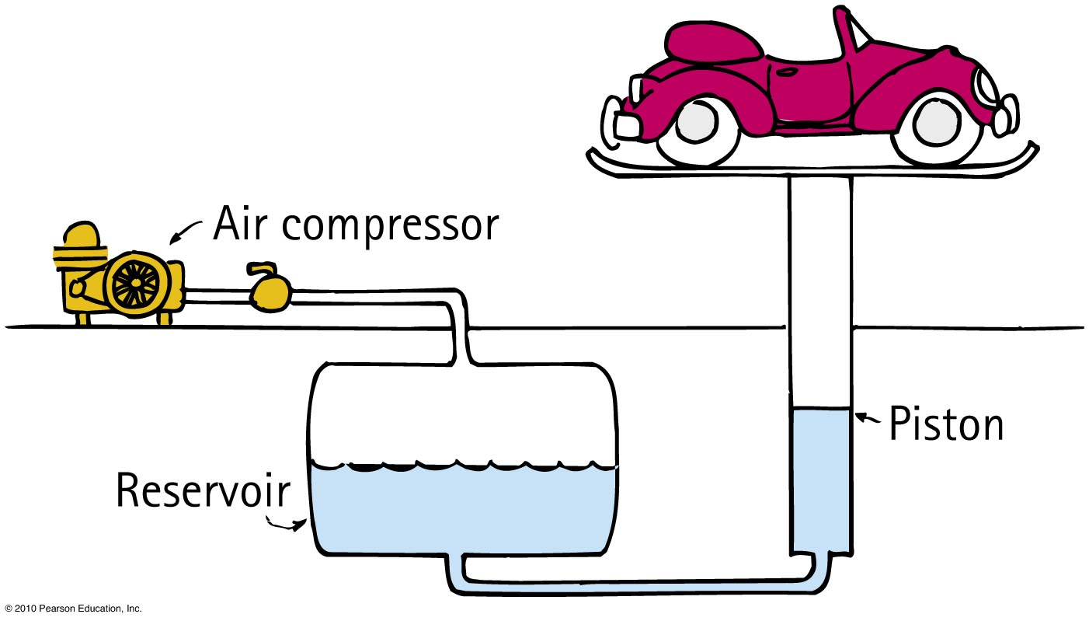
Does a car hoisted for repairs in a service station have increased potential energy relative to the floor?
Potential Energy
CHECK YOUR NEIGHBOR
A. Yes
No
Sometimes
Not enough information
Notes:
A. Yes.

Slide 24
Does a car hoisted for repairs in a service station have increased potential energy relative to the floor?
Potential Energy
CHECK YOUR ANSWER
A. Yes
No
Sometimes
Not enough information
Comment:
If the car were twice as heavy, its increase in potential energy would be twice as great.
Notes:
A. Yes.

Slide 25
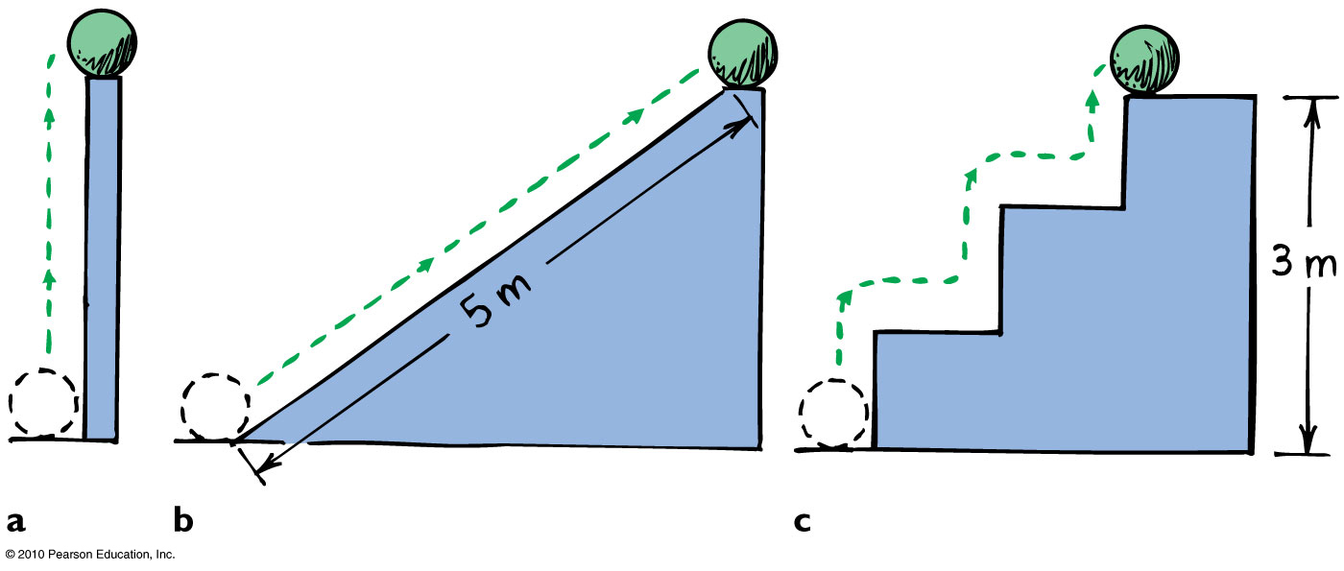
Potential Energy
Example: Potential energy of 10-N ball is the same in all 3 cases because work done in elevating it is the same.

Slide 26
Kinetic Energy
Energy of motion
Depends on the mass of the object and square of its speed
Include the proportional constant 1/2 and
  kinetic energy = 1/2 × mass × speed × speed
If object speed is doubled ⇒ kinetic energy is quadrupled.

Slide 27
Must a car with momentum have kinetic energy?
Kinetic Energy
CHECK YOUR NEIGHBOR
A. Yes, due to motion alone
Yes, when motion is nonaccelerated
Yes, because speed is a scalar and velocity is a vector quantity
No
Notes:
A. Yes, due to motion alone.

Slide 28
Must a car with momentum have kinetic energy?
Kinetic Energy
CHECK YOUR ANSWER
A. Yes, due to motion alone
Yes, when momentum is nonaccelerated
Yes, because speed is a scalar and velocity is a vector quantity
No
Explanation:
Acceleration, speed being a scalar, and velocity being a vector quantity are irrelevant. Any moving object has both momentum and kinetic energy.
Notes:
A. Yes, due to motion alone.

Slide 29
Kinetic Energy
Kinetic energy and work of a moving object
Equal to the work required to bring it from rest to that speed, or the work the object can do while being brought to rest
In equation form: net force × distance =
kinetic energy, or Fd = 1/2 mv²

Slide 30
Work-Energy Theorem
Work-energy theorem
Gain or reduction of energy is the result of work.
In equation form: work = change in kinetic energy (W = ΔKE).
Doubling speed of an object requires 4 times the work.

Slide 31
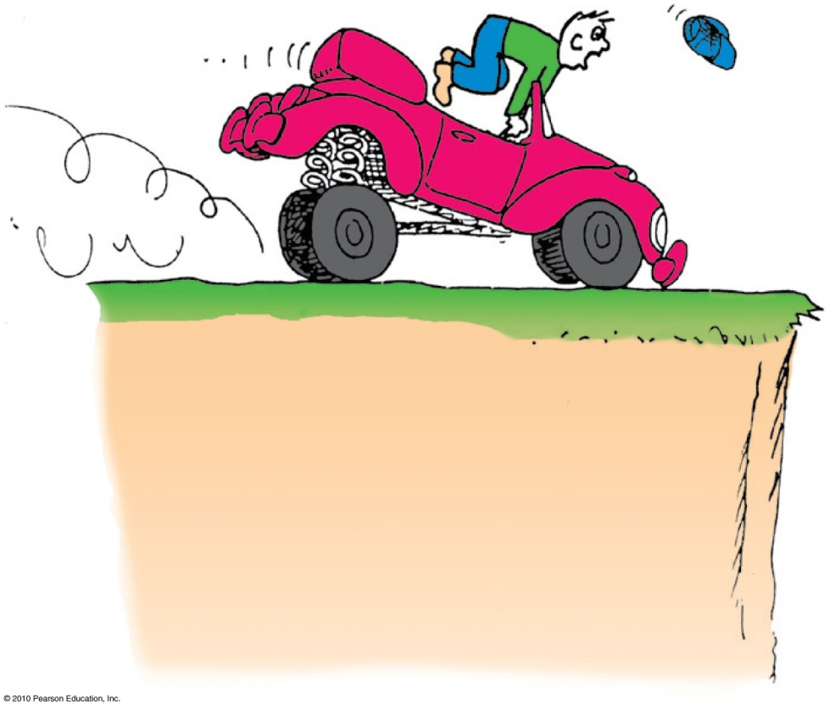
Work-Energy Theorem
Applies to decreasing speed:
  reducing the speed of an object or bringing it to a halt
  Example: Applying the brakes to slow a moving car, work is done on it (the friction force supplied by the brakes × distance).

Slide 32
Consider a problem that asks for the distance of a fast-moving crate sliding across a factory floor and then coming to a stop. The most useful equation for solving this problem is
Work-Energy Theorem
CHECK YOUR NEIGHBOR
A. F = ma.
B. Ft = Δmv.
C. KE = ¹/₂mv².
D. Fd = Δ¹/₂mv².
Notes:
D. Fd = Δ¹/₂mv².

Slide 33
Consider a problem that asks for the distance of a fast-moving crate sliding across a factory floor and then coming to a stop. The most useful equation for solving this problem is
Work-Energy Theorem
CHECK YOUR ANSWER
A. F = ma.
B. Ft = Δmv
C. KE = ¹/₂mv².
D. Fd = Δ¹/₂mv².
Comment:
The work-energy theorem is the physicist’s favorite starting point for solving many motion-related problems.
Notes:
D. Fd = Δ¹/₂mv².

Slide 34
The work done in bringing a moving car to a stop is the force of tire friction × stopping distance. If the initial speed of the car is doubled, the stopping distance is
Work-Energy Theorem
CHECK YOUR NEIGHBOR
A. actually less.
about the same.
twice.
None of the above.
Notes:
D. none of the above.

Slide 35
The work done in bringing a moving car to a stop is the force of tire friction × stopping distance. If the initial speed of the car is doubled, the stopping distance is
Work-Energy Theorem
CHECK YOUR ANSWER
A. actually less.
about the same.
twice.
None of the above.
Explanation:
Twice the speed means four times the kinetic energy and four times the stopping distance.
Notes:
D. none of the above.

Slide 36
Conservation of Energy
Law of conservation of energy
Energy cannot be created or destroyed; it may be transformed from one form into another, but the total amount of energy never changes.

Slide 37
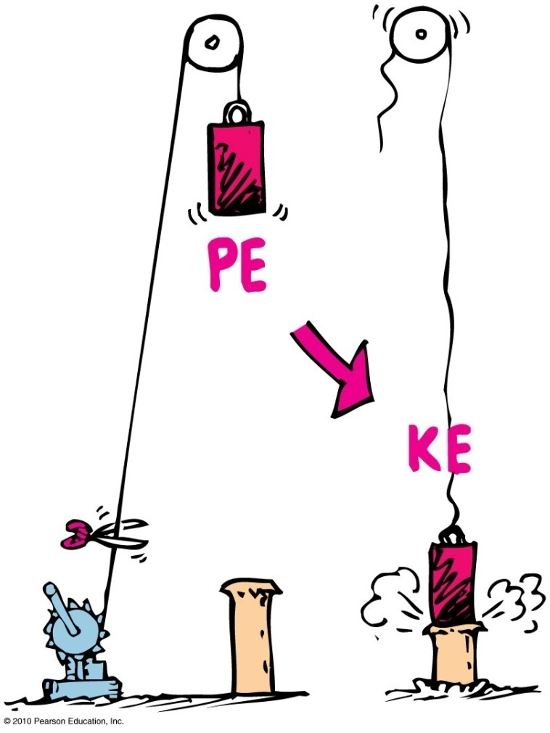
Conservation of Energy
Example: Energy transforms without net loss or net gain in the operation of a pile driver.

Slide 38
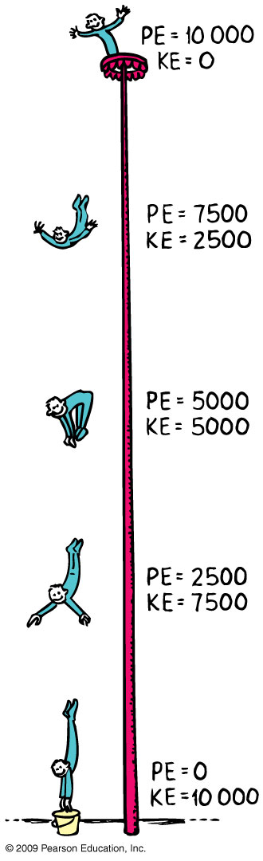
Conservation of Energy
Energy cannot be created or destroyed; it can only be transformed from one form to another.

Slide 39
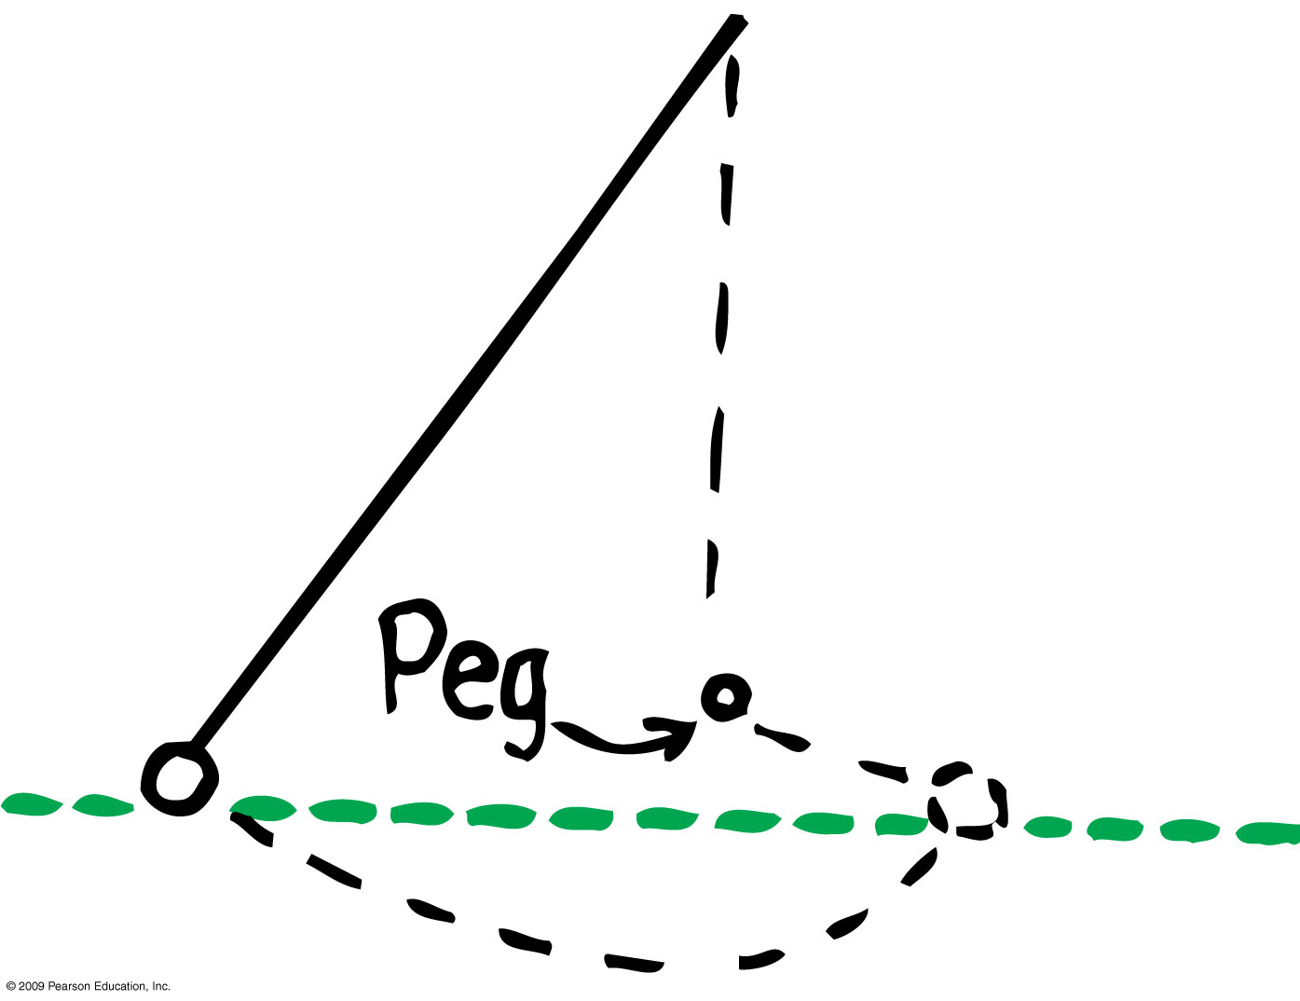
Figure 7.9

Slide 40
Conservation of Energy
A situation to ponder…
Consider the system of a bow and arrow. In drawing the bow, we do work on the system and give it potential energy. When the bowstring is released, most of the potential energy is transferred to the arrow as kinetic energy and some as heat to the bow.

Slide 41
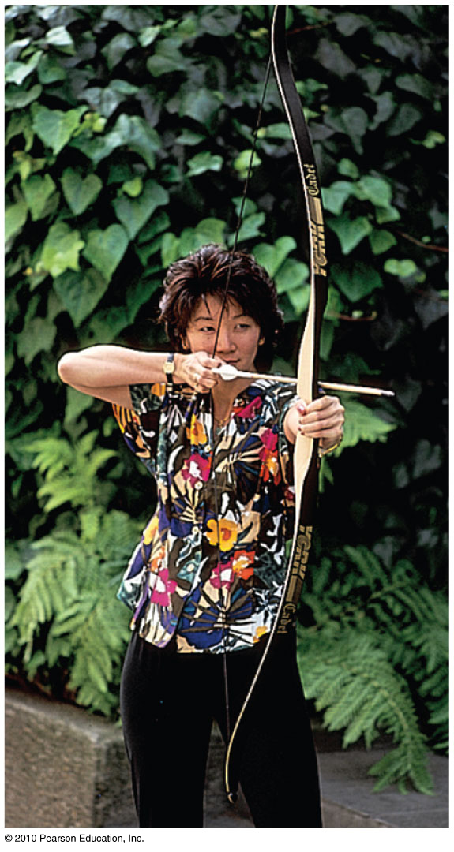
Suppose the potential energy of a drawn bow is 50 joules and the kinetic energy of the shot arrow is 40 joules. Then
A situation to ponder…
CHECK YOUR NEIGHBOR
A. energy is not conserved.
10 joules go to warming the bow.
10 joules go to warming the target.
10 joules are mysteriously missing.
Notes:
B. 10 joules go to warming the bow.

Slide 42
Suppose the potential energy of a drawn bow is 50 joules and the kinetic energy of the shot arrow is 40 joules. Then
A situation to ponder…
CHECK YOUR ANSWER
A. energy is not conserved.
10 joules go to warming the bow.
10 joules go to warming the target.
10 joules are mysteriously missing.
Explanation:
The total energy of the drawn bow, which includes the poised arrow, is 50 joules. The arrow gets 40 joules and the remaining 10 joules warms the bow—still in the initial system.
Notes:
B. 10 joules go to warming the bow.

Slide 43
Kinetic Energy and Momentum Compared
Similarities between momentum and kinetic
energy:
Both are properties of moving things.
Difference between momentum and kinetic energy:
Momentum is a vector quantity and therefore is directional and can be canceled.
Kinetic energy is a scalar quantity and can never be canceled.

Slide 44
Kinetic Energy and Momentum Compared
Velocity dependence
  Momentum depends on velocity.
  Kinetic energy depends on the square of velocity.
  Example: An object moving with twice the velocity of another with the same mass, has twice the momentum but 4 times the kinetic energy.

Slide 45
Machines
Machine
Device for multiplying forces or changing the direction of forces
Cannot create energy but can transform energy from one form to another, or transfer energy from one location to another
Cannot multiply work or energy

Slide 46
Machines
Principle of a machine
Conservation of energy concept:
Work input = work output
Input force × input distance =
Output force × output distance
(Force × distance)_{input} = (force × distance)_{output}

Slide 47
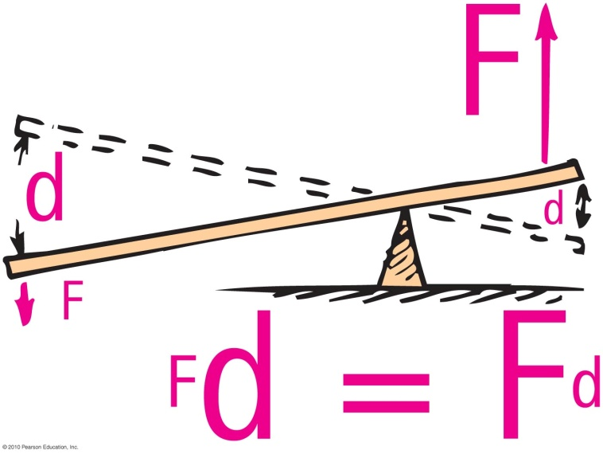
Machines
Simplest machine
Lever
  rotates on a point of support called the fulcrum
  allows small force over a large distance and large force over a short distance

Slide 48
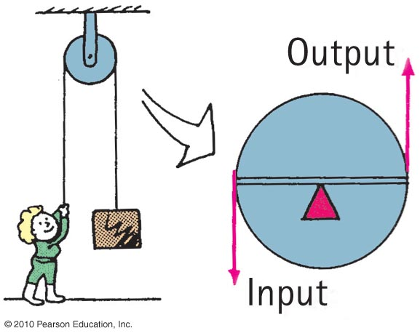
Machines
Pulley
  operates like a lever with equal arms— changes the direction of the input force
  Example:
    This pulley arrangement can allow a load to be lifted with half the input force.

Slide 49
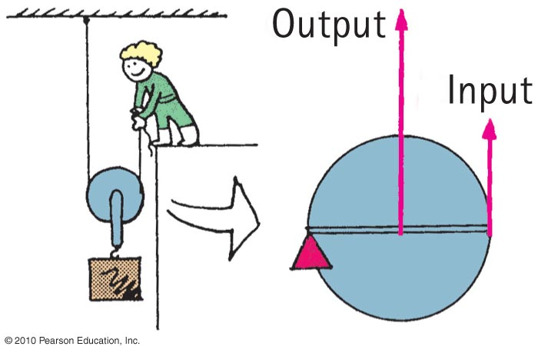
Machines
  Operates as a system of pulleys (block and tackle)
  Multiplies force

Slide 50
In an ideal pulley system, a woman lifts a 100-N crate by pulling a rope downward with a force of 25 N. For every 1-meter length of rope she pulls downward, the crate rises
Machines
CHECK YOUR NEIGHBOR
A. 50 centimeters.
45 centimeters.
25 centimeters.
None of the above.
Notes:
C. 25 centimeters.

Slide 51
In an ideal pulley system, a woman lifts a 100-N crate by pulling a rope downward with a force of 25 N. For every 1-meter length of rope she pulls downward, the crate rises
Machines
CHECK YOUR ANSWER
A. 50 centimeters.
45 centimeters.
25 centimeters.
None of the above.
Explanation:
Work in = work out; Fd in = Fd out.
One-fourth of 1 m = 25 cm.
Notes:
C. 25 centimeters.

Slide 52
Efficiency
Efficiency
Percentage of work put into a machine that is converted into useful work output
In equation form:
useful energy output
Efficiency =
total energy input

Slide 53
A certain machine is 30% efficient. This means the machine will convert
Efficiency
CHECK YOUR NEIGHBOR
A. 30% of the energy input to useful work—70% of the energy input will be wasted.
70% of the energy input to useful work—30% of the energy input will be wasted.
Both of the above.
None of the above.
Notes:
A. 30% of the energy input to useful work—70% of the energy input will be wasted.

Slide 54
A certain machine is 30% efficient. This means the machine will convert
Efficiency
CHECK YOUR ANSWER
A. 30% of the energy input to useful work—70% of the energy input will be wasted.
70% of the energy input to useful work—30% of the energy input will be wasted.
Both of the above.
None of the above.
Notes:
A. 30% of the energy input to useful work—70% of the energy input will be wasted.

Slide 55
Recycled Energy
Re-employment of energy that otherwise would be wasted.
Edison used heat from his power plant in New York City to heat buildings.
Typical power plants waste about 30% of their energy to heat because they are built away from buildings and other places that use heat.

Slide 56
Energy for Life
Body is a machine, so it needs energy.
Our cells feed on hydrocarbons that release energy when they react with oxygen
(like gasoline burned in an automobile).
There is more energy stored in the food than in the products after metabolism.

Slide 57
Sources of Energy
Sources of energy
Sun
  Example:
    Sunlight evaporates water; water falls as rain; rain flows into rivers and into generator turbines; then back to the sea to repeat the cycle.
    Sunlight can be transformed into electricity by photovoltaic cells.
    Wind power turns generator turbines.

Slide 58
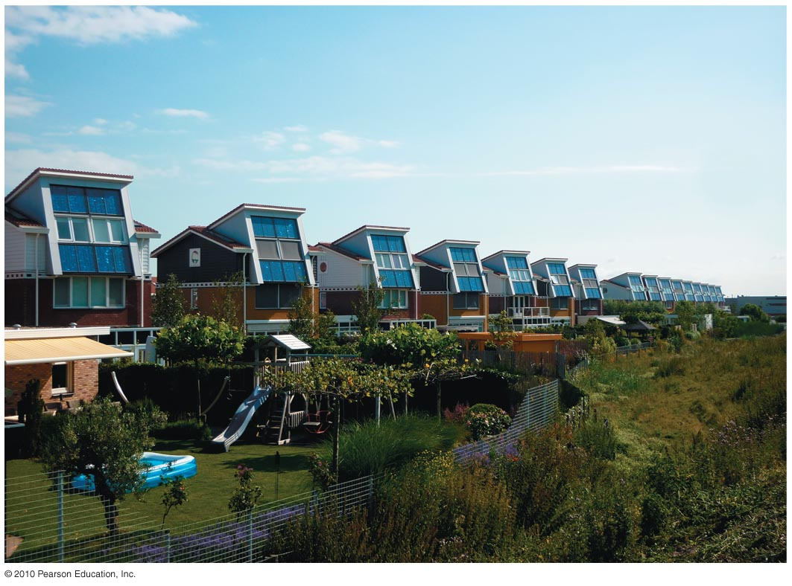
Sources of Energy
Sources of energy
Sun
  Example:
    Photovoltaic cells on rooftops catch the solar energy and convert it to electricity.
More energy from the Sun hits Earth in 1 hour than all of the energy consumed by humans in an entire year!

Slide 59
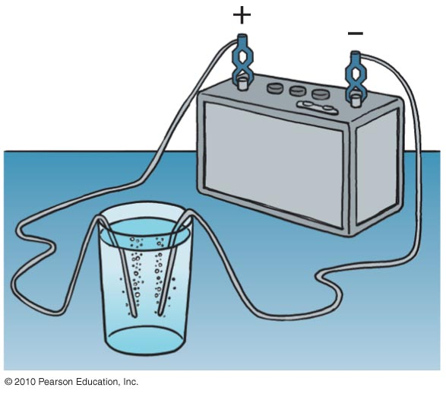
Sources of Energy
Fuel cell
Runs opposite to the battery shown (where electricity separates water into hydrogen and oxygen).
In a fuel cell, hydrogen and oxygen are compressed at electrodes and electric current is produced at electrodes.

Slide 60
Sources of Energy
Concentrated energy
Nuclear power
  stored in uranium and plutonium
  by-product is geothermal energy
    held in underground reservoirs of hot water to provide steam that can drive turbogenerators

Slide 61
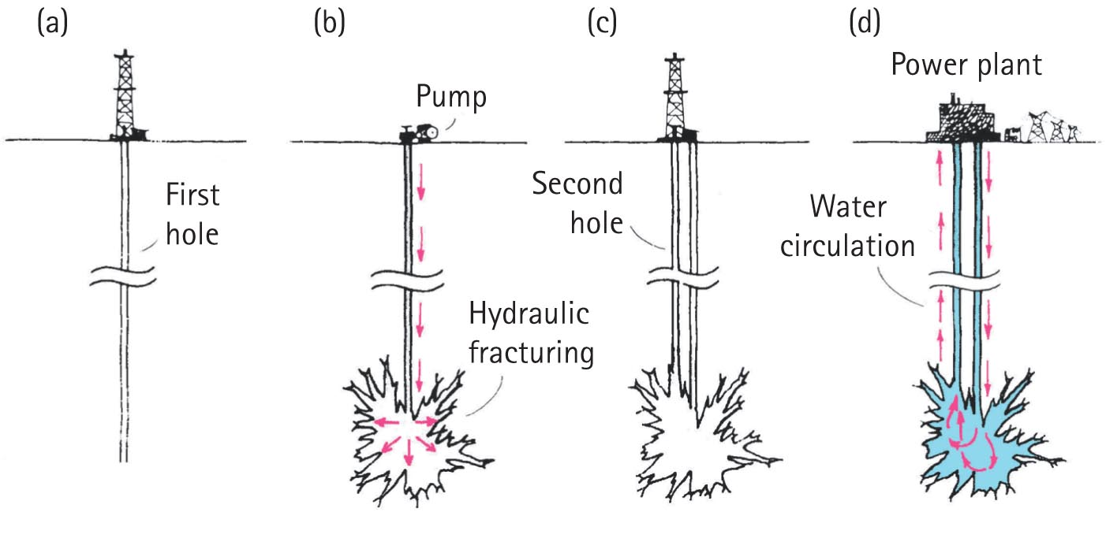
Sources of Energy
Dry-rock geothermal power is a producer of electricity.
  Water is put into cavities in deep, dry, hot rock. Water turns to steam and reaches a turbine, at the surface. After exiting the turbine, it is returned to the cavity for reuse.

Slide 62
Chapter 7 Problems
The second floor of a house is 6 m above the street level. How much work is required to lift a 300-kg refrigerator
to the second-story level?
W = F·d = m·g·h = 300kg 10 m/s² 6 m = 18000 Joules.
How much work is done when you push a crate hori­zontally with 100 N across a 10-m factory floor?
W = F·d = 100 N·10 m = 1000 J.
(b) If the force of friction on the crate is a steady 70 N, show that the KE gained by the crate is 300 J.
ΔKE = W - F_{friction}·d = 1000J – 70 N·10 m = 300 J.
(c) Show that 700 J is turned into heat.
Heat = Energy loss to Friction = 70 N·10 m = 700 J.

Slide 63
Chapter 7 Problems
4. Belly-flop Bernie dives from atop a tall flagpole into a swimming pool below. His potential energy at the top is
10,000 J (relative to the surface of the pool). What is his kinetic energy when his potential energy reduces to 1000 J?
KE + PE = Constant.
At the top PE = 10,000 J , KE = 0
Constant = 10,000J
When PE = 1,000J , KE + 1,000 J = 10,000 J and,
KE = 10,000 J – 1,000 J = 9,000 J

Slide 64
Chapter 7 Problems
Consider an ideal pulley system. If you pull one end of the rope 1 m downward with a 50-N force, show that you can lift a 200-N load one-quarter of a meter high.
Work input = Work output or F_{in} d_{in} = F_{out} d_{out} then,
50 N 1 m = 200 N dout and
d_{out} = 50N 1m / 200N = ¼ m

Slide 65
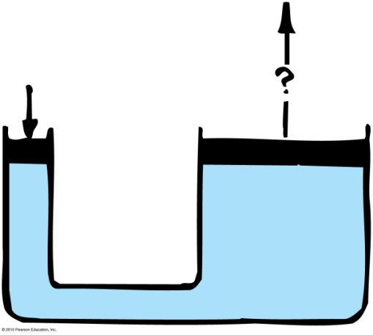
Chapter 7 Problems
8. In the hydraulic machine shown, you observe that when the small piston is pushed down 10 cm, the large piston is raised 1 cm. If the small piston is pushed down with a force of 100 N, what is the most weight that the large piston can support?
F_{in} d_{in} = F_{out} d_{out} then
100 N 10 cm = F_{large} 1cm or
F_{large} = 100N 10cm / 1 cm = 1,000 N

Slide 66
Chapter 7 Problems
10. Emily holds a banana of mass m over the edge of a bridge of height h. She drops the banana and it falls to the river below. Use conservation of energy to show that the speed of the banana just before hitting the water is v = (2gh)^{1/2}
PE_{bridge} = KE _{water} or, mgh = ½ mv² then v² = 2gh and
v = (2gh)^{1/2}

